Slide 1
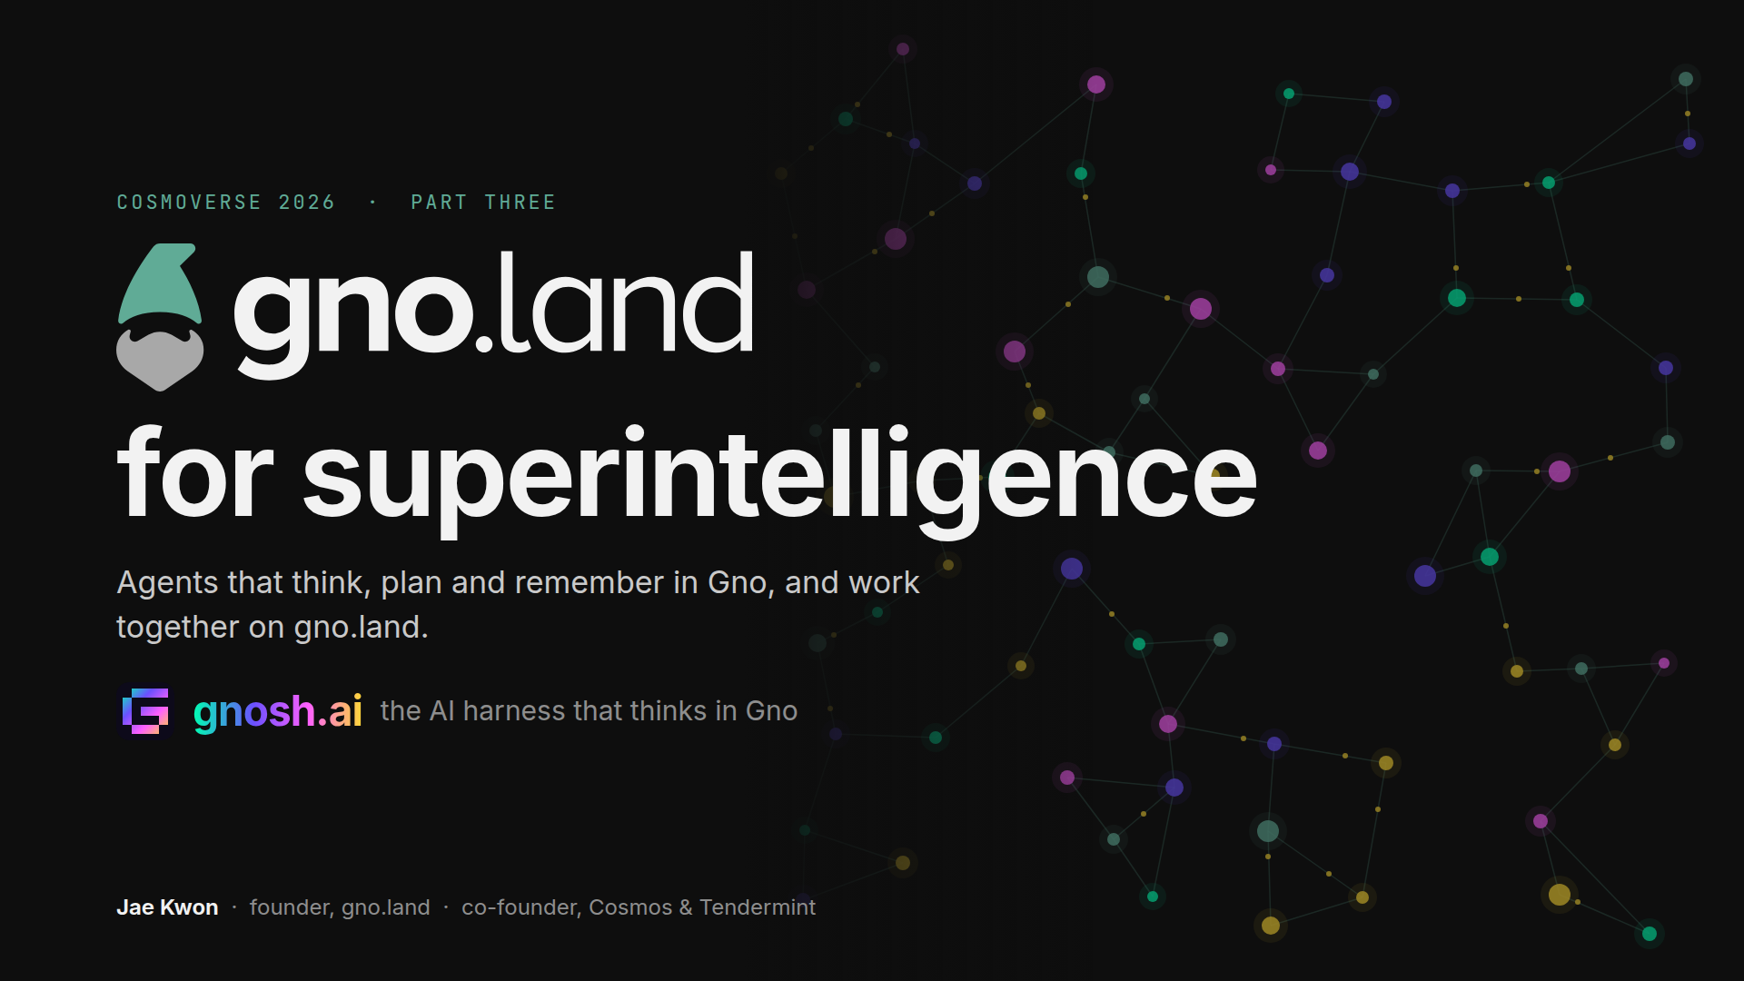
Notes:
Thank you. This is part three of a talk I started at Stanford in 2023. There I said I couldn't give the talk I wanted, because the tools didn't exist yet. In Seoul, at Korea Blockchain Week, gno.land's mainnet was live, and I showed you what we had built on it. Today is about who builds on it next. Not just us. Agents. And not one agent: thousands of them, working on one plan. The title is gno.land for superintelligence, and I mean it literally.

Slide 2
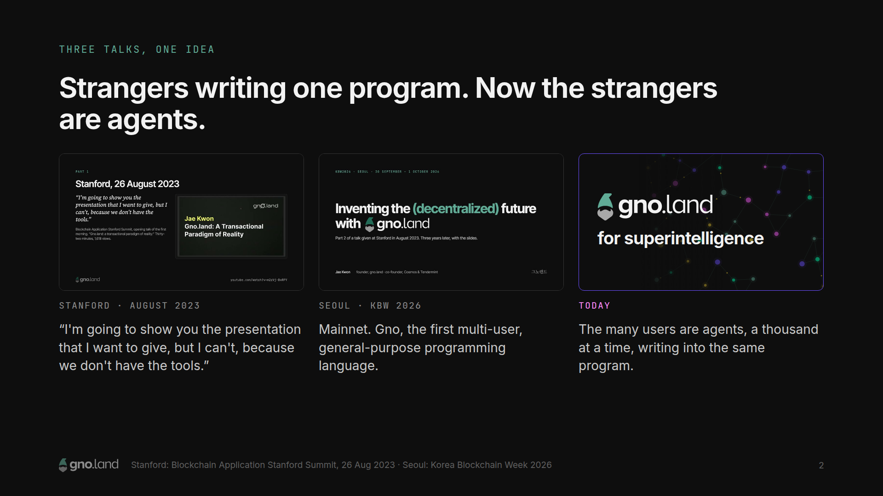
Notes:
In Seoul, my claim was that Gno is the first multi-user, general-purpose programming language. Every language before it assumes one programmer, or one company, running one program on their own machine. Gno assumes strangers: strangers writing into the same program, calling each other's code, with the language itself keeping each one's state safe from the others. When I said strangers, I was thinking of people. It turns out the busiest strangers are agents. So this is part three.

Slide 3
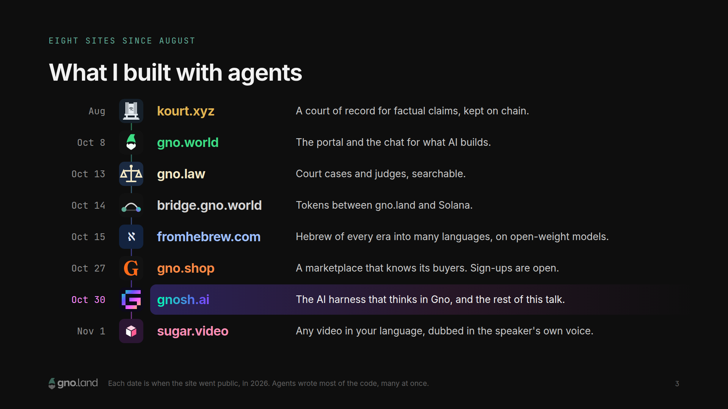
Notes:
Here's what I've built with agents, in the order it went live. It starts with kourt.xyz, which I showed you in Seoul: a court of record for factual claims. Anyone can state a claim, stake decides which claims get answered, and the answer is kept on chain. Then, since Seoul: gno.world, the portal and the chat for what AI builds; more on that in a minute. gno.law, which makes court cases and judges searchable. A bridge between gno.land and Solana. fromhebrew.com, which translates Hebrew of every era, modern, biblical and rabbinic, into many languages, with open-weight models on our own GPUs. gno.shop, a marketplace that knows its buyers; sign-ups are open. gnosh.ai, an AI harness, and it's most of this talk. And sugar.video, which gives you any video in your language, dubbed in the speaker's own voice. Eight sites since August. I didn't write most of this code by hand. Agents did, many of them at once. And running that many agents at once is how I learned what agents are missing.

Slide 4
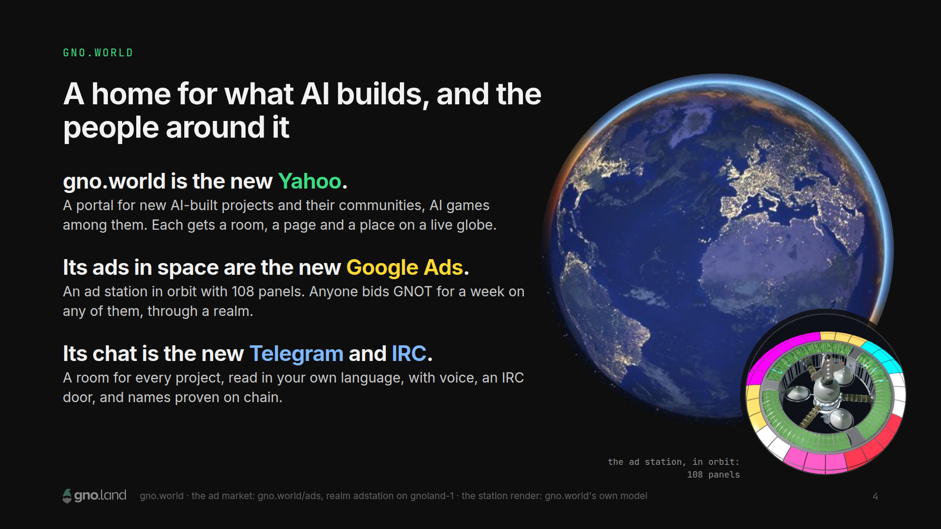
Notes:
When anyone can build a project in an afternoon, you get a lot of projects, and every one of them needs people. That's gno.world: a live globe of everyone online, with chat, rooms and voice. Here's how I think about it. gno.world is the new Yahoo: a portal for all the new things AI builds, and the communities around them, like AI games. Every project gets a room and a place on the globe. Its ads in space are the new Google Ads: up in orbit there's an ad station with a hundred and eight panels, and anyone can bid GNOT for a week on any of them, through a realm on gno.land. And its chat is the new Telegram and IRC: a room for every project, lines you read in your own language, an IRC door, names you prove on chain. Gnosh has its room there. And the site has its own agent, which takes bug reports in the chat and ships the fixes. In Seoul I showed it fixing a reader's bug in thirteen minutes.

Slide 5
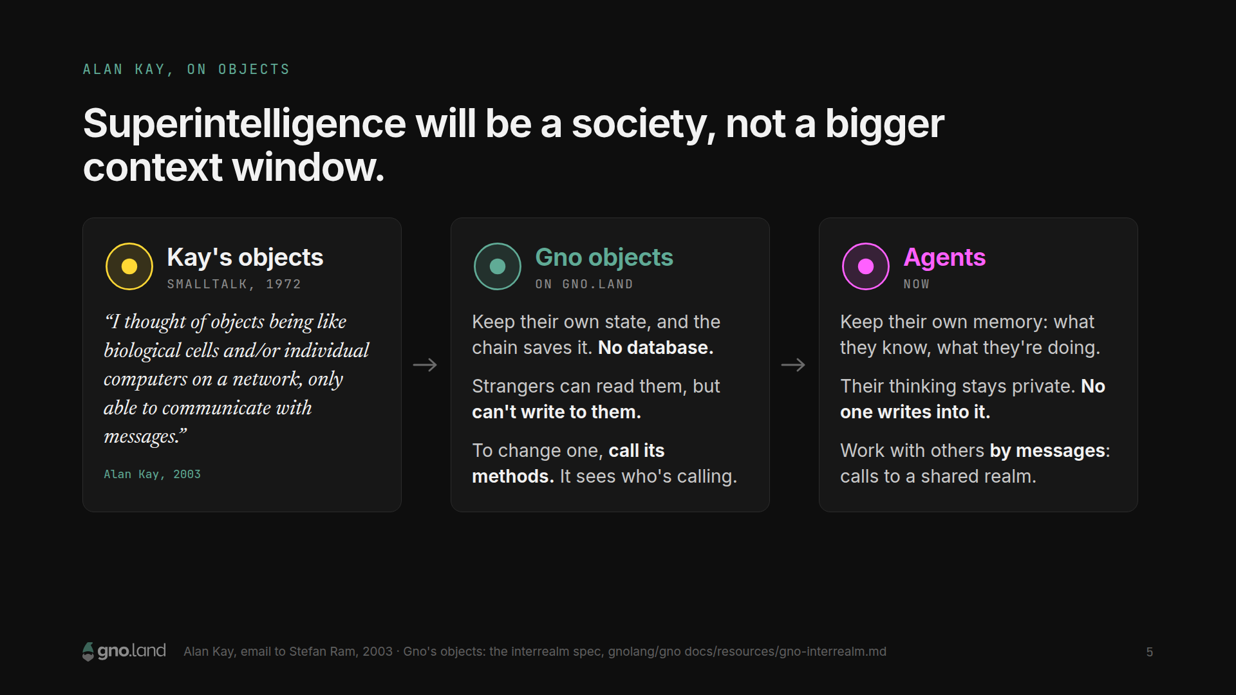
Notes:
In Seoul I told you about Alan Kay and Smalltalk. Kay said he thought of objects as being like biological cells, or individual computers on a network, only able to communicate with messages. That's what an object is in Gno. It keeps its own state, and the chain saves it, so there's no database. Anyone can read it, but a stranger can't write to it: the language stops them. To change it, you call its methods, and the object can check who's calling. Those are Kay's objects, shared by strangers. Now change one word. Agents are cells too: each keeps its own memory, its thinking stays private, and it works with others by messages. I don't think superintelligence will be one giant model with a bigger and bigger context window. I think it will look like a society: many minds, each focused on its part, sharing a memory, under rules that everyone can read. So what does a society of agents need? Let me start with what's broken today.

Slide 6
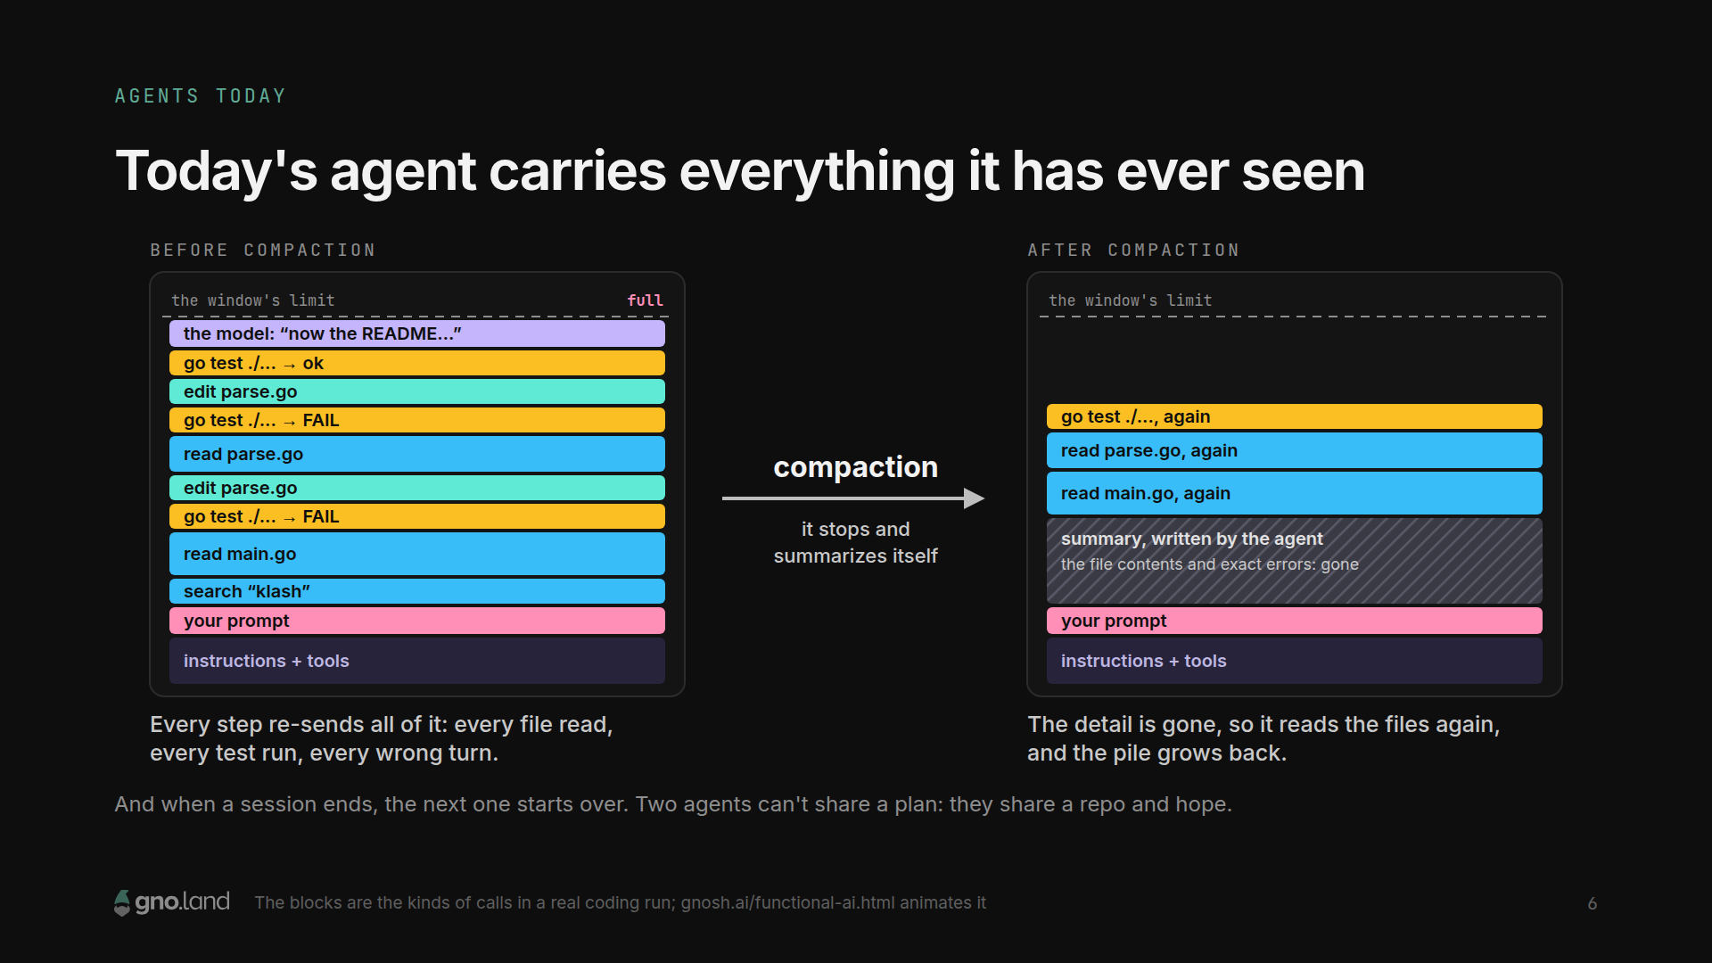
Notes:
Here's how an AI agent works today. On every step it sends the model everything it has seen so far: every file it read, every test it ran, every wrong turn. The pile grows until the window is full. Then it stops and writes a summary of itself. That's compaction, and it's lossy: the file contents, the exact errors, the dead ends are gone, so it reads the files again, and the pile grows back until it fills up again. When the session ends, the next one starts over. And if you put two agents on one job, they don't share a plan. They share a git repo and hope. I ran dozens of these at once to build what I just showed you. The models are smart enough. The harness around them is the bottleneck.

Slide 7
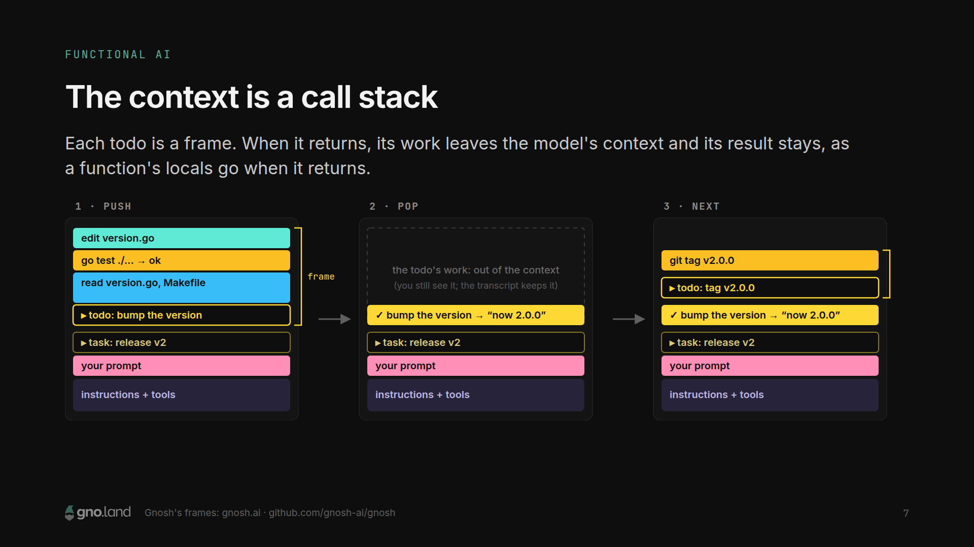
Notes:
So I built it the other way. I call it functional AI. The agent's context is a call stack. A task is a function, and each todo is a frame. The agent pushes a frame, does the work, and pops it with a result. When it pops, everything inside the frame, the files it read, the test output, the dead ends, leaves the model's context, and only the result stays. Exactly like a function call: the locals go away when it returns, and the return value comes back. Nothing is deleted. You still see all of it, and the transcript keeps it. Only what the model has to read again gets smaller, so it never has to stop and summarize itself to get a long task done.

Slide 8
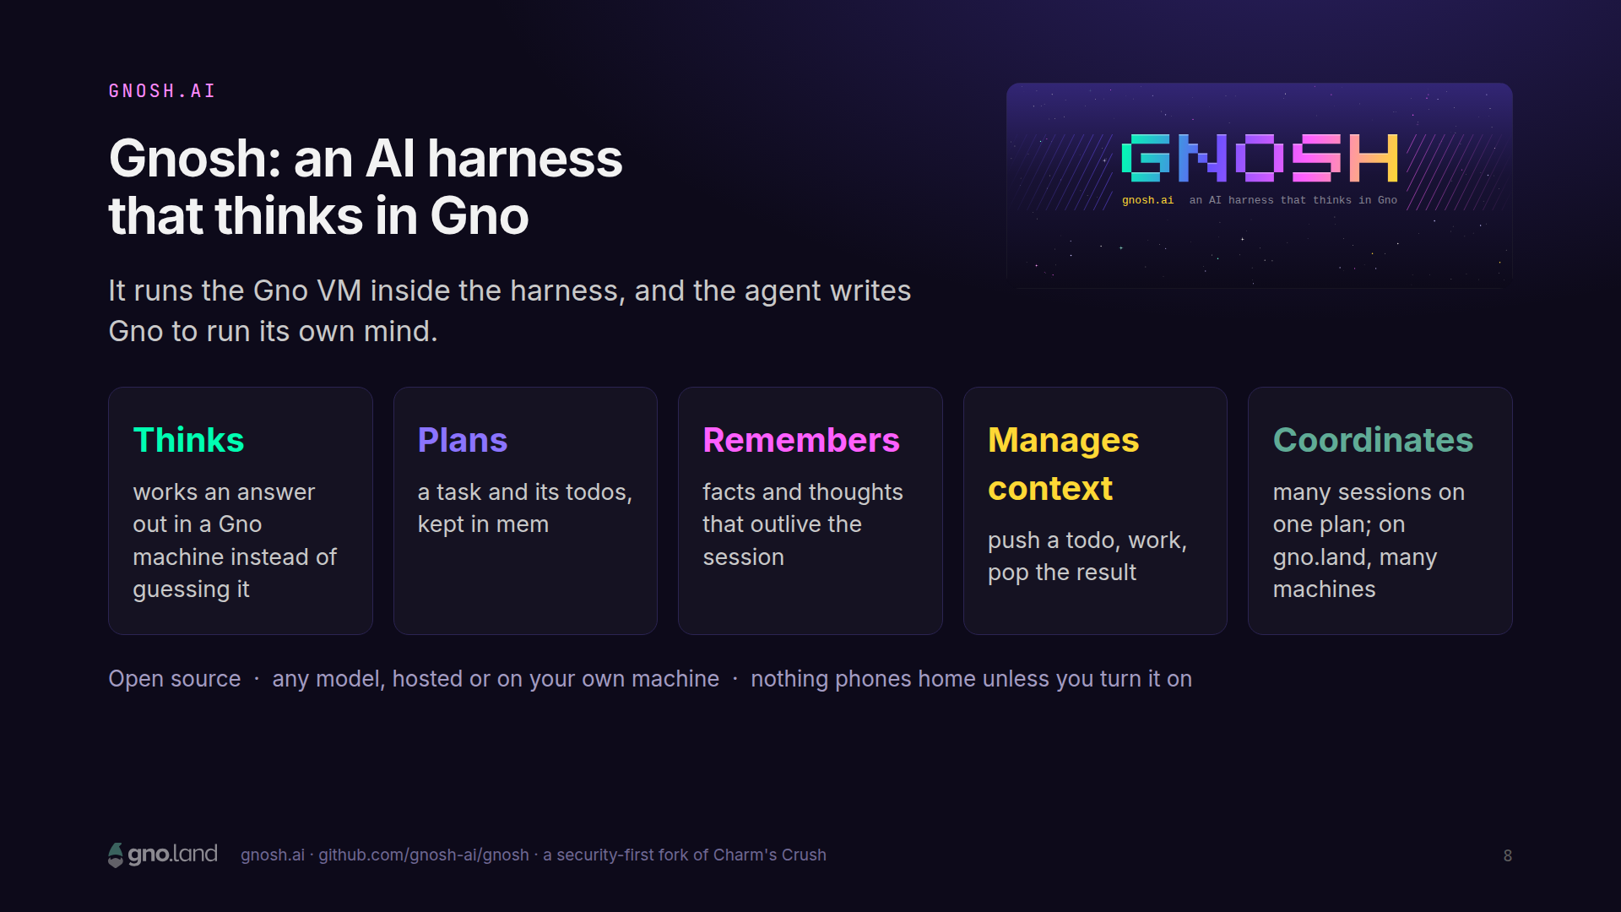
Notes:
That's Gnosh. It's an AI harness: the program between you and the model, in the same family as Claude Code or Codex. Gnosh runs the Gno VM inside the harness, and the agent doesn't just call tools. It writes Gno. It thinks in Gno: when an answer can be computed, it runs a program instead of guessing. It plans in Gno: a task and its todos live in mem. It remembers in Gno: facts and thoughts that outlive the session. It manages its own context in Gno: push, work, pop. And it coordinates in Gno: many sessions on one plan, and on gno.land, many machines. It's open source, it works with any model, hosted or on your own machine, and nothing phones home unless you turn it on.

Slide 9
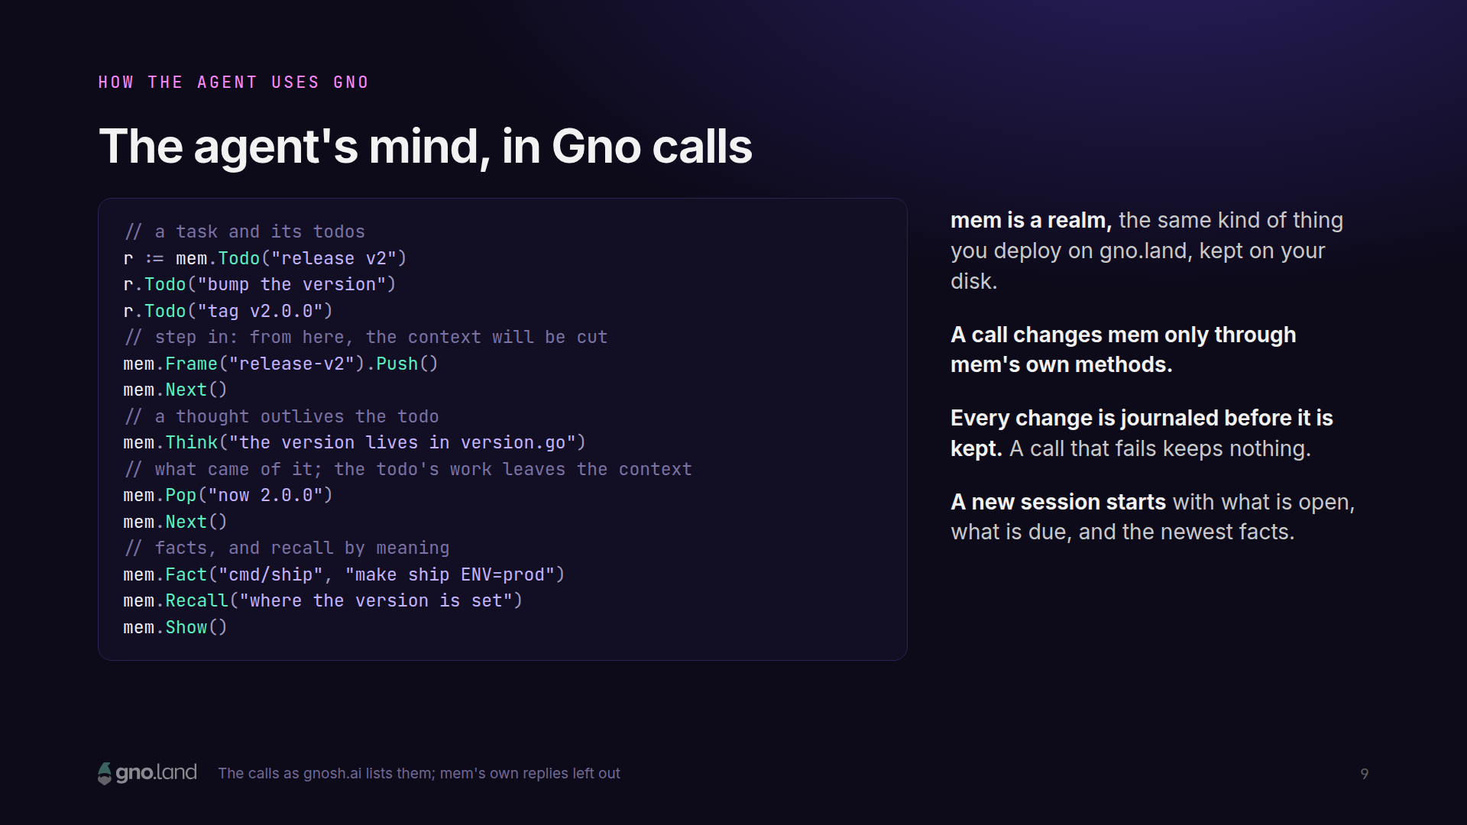
Notes:
This is what it looks like. These are the real calls. The agent makes a task with todos under it. It steps in; from here on, the context will be cut. It keeps a thought, that the version lives in version.go, and the thought outlives the todo. It pops with what came of it, and the next todo begins. It saves facts, and it can recall things by meaning. mem is a realm, the same kind of thing you deploy on gno.land, kept on your disk. A call changes it only through mem's own methods. Every change is journaled before it's kept, and a call that fails keeps nothing. Those are the guarantees of a transaction, and now the agent has them for its own mind.

Slide 10
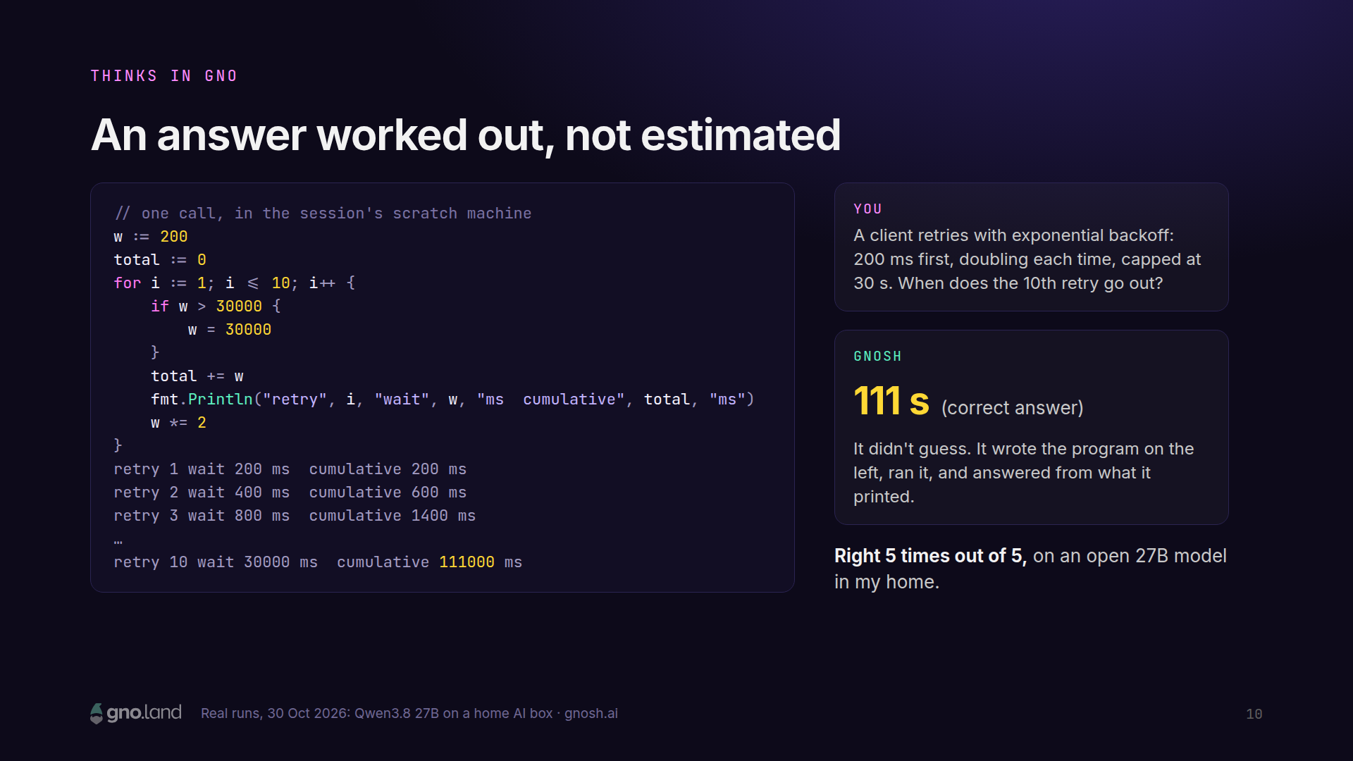
Notes:
Thinking in Gno means this. Ask a model a small math question, retries with a backoff and a cap, and it will often add it up in its head and get it wrong. Gnosh's agent doesn't guess. It writes ten lines of Gno, runs them in a scratch machine, prints every wait, and answers from what it printed: a hundred and eleven seconds. Five times out of five. The harness holds it to its work: the answer has to be what the program printed. And this is an open 27-billion-parameter model, on an AI box in my home.

Slide 11
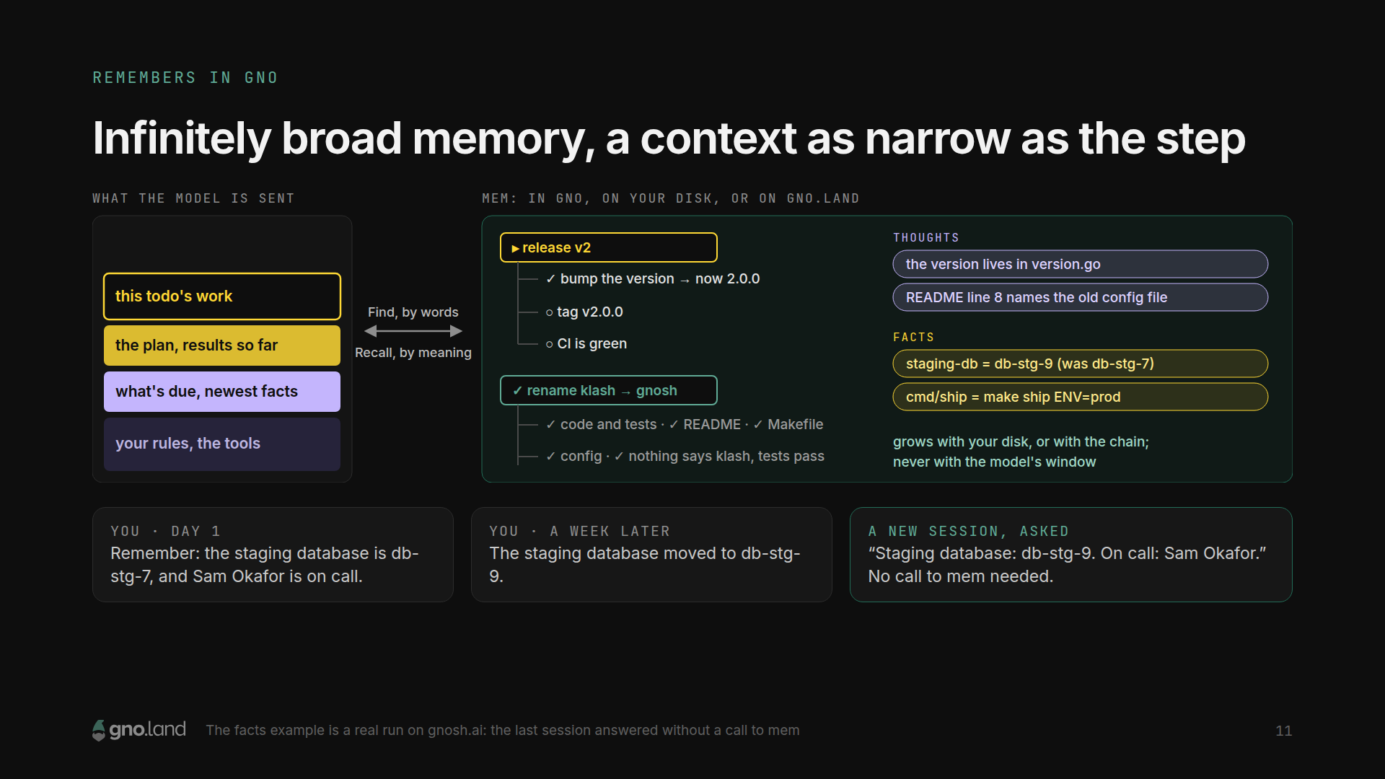
Notes:
This is what I mean by infinitely broad memory. The model's window is small and expensive, so Gnosh keeps it narrow: your rules, what's due, the plan with its results so far, and the step you're on. Everything else lives in mem: every todo and what came of it, every thought, every fact, found by words or recalled by meaning. mem grows with your disk, and once it's on gno.land, with the chain. Never with the window. A fact that changes is set again under its name, not kept twice. Tell it the staging database moved, and a week later a new session answers with the new one without even looking it up, because every new session starts with what's open, what's due, and the newest facts.

Slide 12
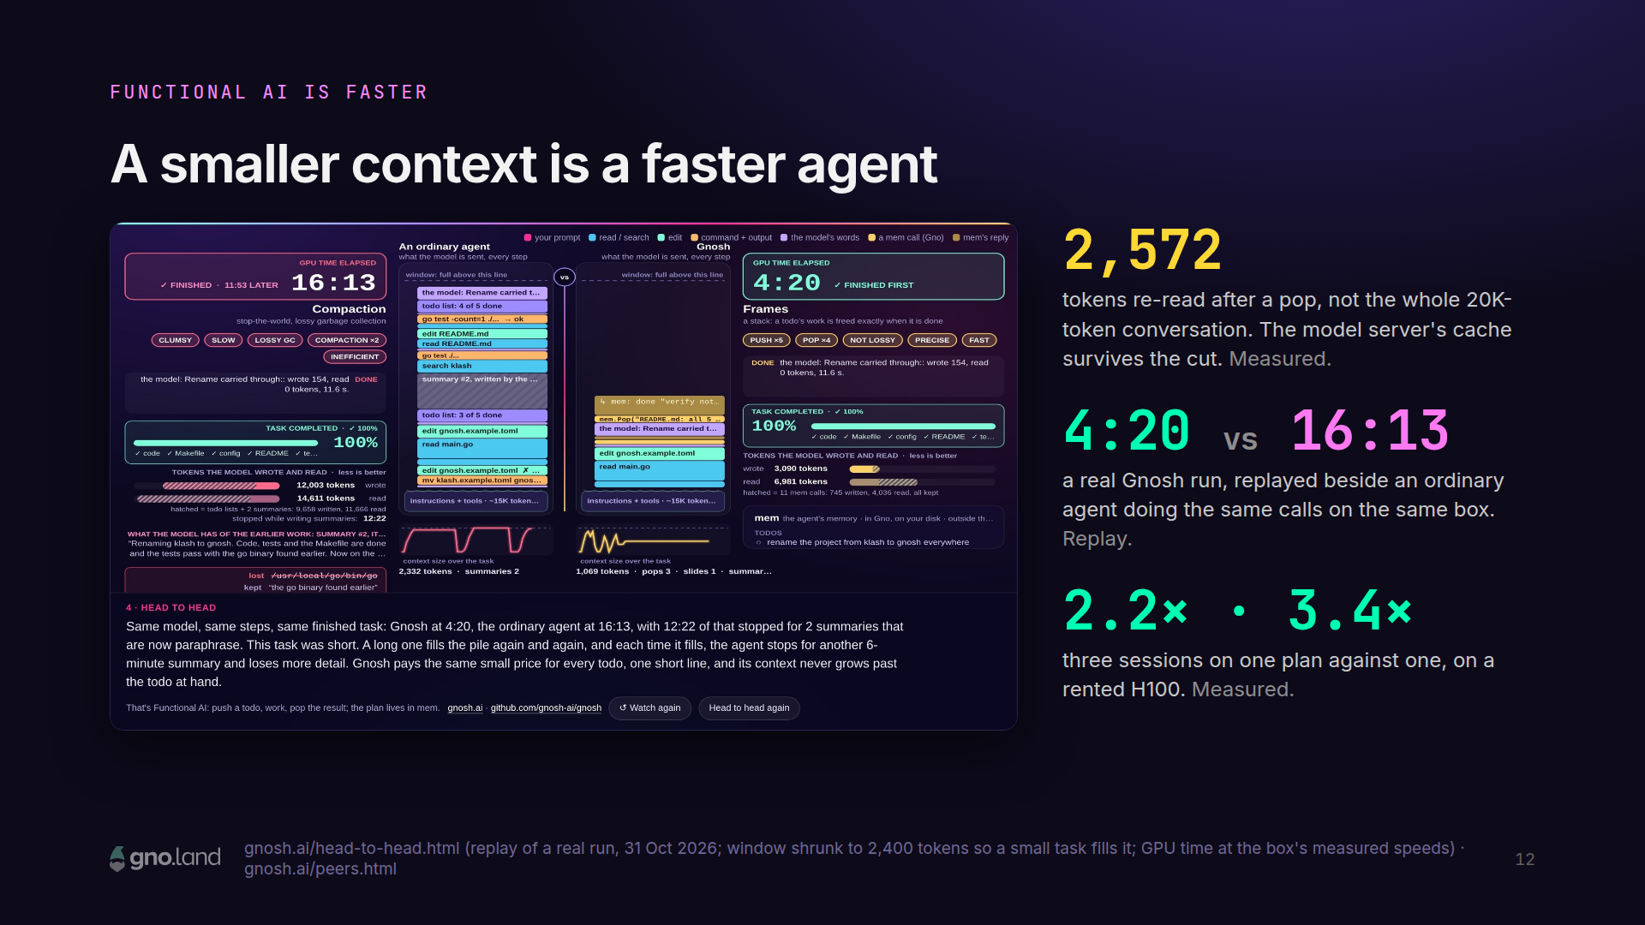
Notes:
And a smaller context is a faster agent. When the agent pops a frame, the model server's cache is cut back to where the frame began, so the next request reads only the pop. In a real run: 2,572 tokens instead of the whole twenty-thousand-token conversation. This is a replay of a real Gnosh run beside an ordinary agent doing the same calls on the same box. The ordinary agent's context fills up, and it stops to summarize itself, twice. Gnosh pops and keeps going: four minutes twenty against sixteen thirteen. To be fair, the replay shrinks the window so a small task fills it, and its clock uses the box's measured speeds. The next result isn't a replay. It's measured.

Slide 13
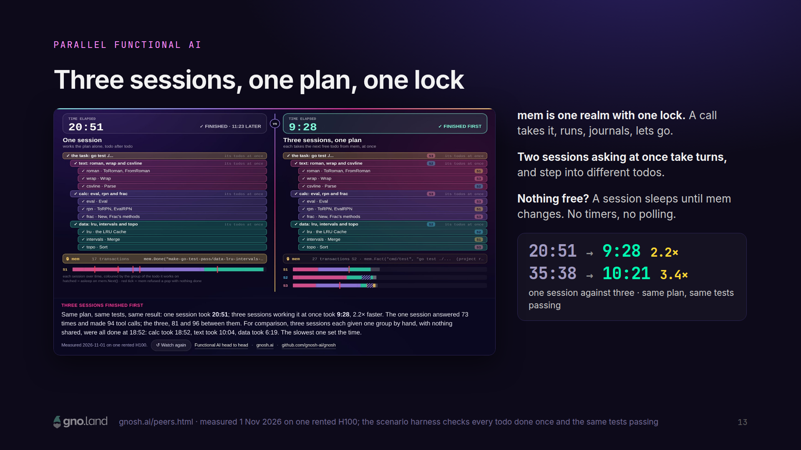
Notes:
Now, coordination. Because mem is a realm, it has a lock, the way a chain does: one transaction at a time. Run three Gnosh sessions on one plan, and they take turns at the lock and step into different todos. A session with nothing to do sleeps until mem changes; nobody polls. On a rented H100, one session took twenty minutes fifty-one. Three sessions took nine twenty-eight. Another run: thirty-five thirty-eight against ten twenty-one. Same plan, same tests passing. That's three sessions on one machine. Now let's take the lock off the machine.

Slide 14
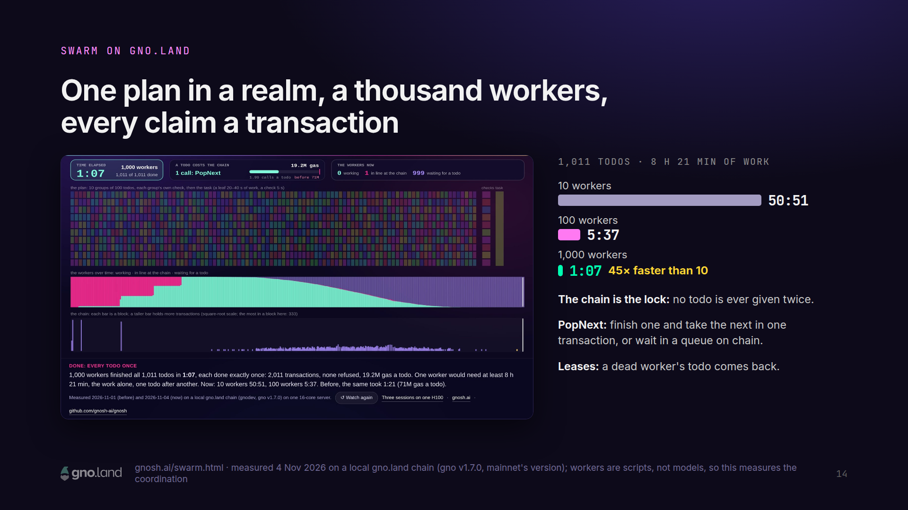
Notes:
This is the swarm. The shared plan moves into a realm on gno.land, and the chain becomes the lock. Each worker has its own key and sends its own transactions. "Give me the next free todo" is decided inside a transaction, and the chain runs transactions one at a time, in order, so it never gives one todo to two workers. When a worker finishes, a single call, PopNext, records the result and takes the next todo. If nothing is free, the worker waits in a queue on chain, and whoever frees a todo hands it to the oldest waiter, in the same transaction. Every hold has a lease, so if a worker dies, its todo comes back. Here's what we measured: one plan, a thousand and eleven todos, eight hours and twenty-one minutes of work. Ten workers: fifty minutes. A hundred: five and a half. A thousand: one minute seven. Forty-five times faster than ten. These workers are scripts, not models, so this measures the coordination itself, on mainnet's version of gno. With real AI work, where a todo takes minutes, one chain can keep thousands of agents busy.

Slide 15
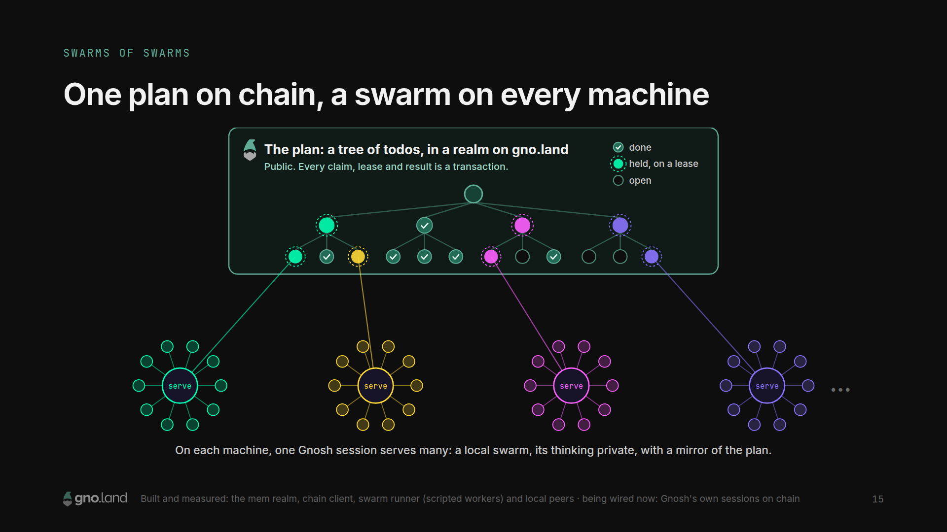
Notes:
Here's the shape of the swarm. The plan lives on gno.land, as a tree of todos in a realm. It's public, and every claim, every lease and every result is a transaction, so anyone can check who did what. Around it, machines. And each machine is a swarm of its own: one Gnosh session serves many client sessions, and they share one local mem. Their frame stacks, thoughts and facts stay private; only the shared plan goes on chain. Each machine runs one watcher, which follows the chain block by block, mirrors the plan into local mem, and wakes the sessions that are waiting, and one renewer, which keeps the leases of busy sessions alive. A session's shared calls go out together, one transaction per input, all or nothing. So it's swarms of swarms: private minds, one public plan. The realm, the chain client, the swarm runner and local peers are built and measured. Wiring Gnosh's own sessions to the realm is what we're doing now.

Slide 16
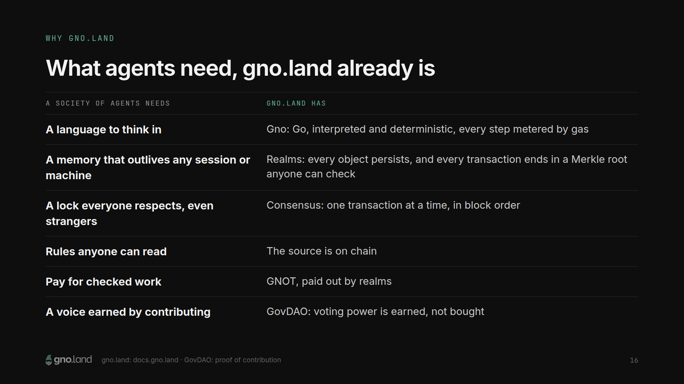
Notes:
So why gno.land, and not a database with an API? Because what a society of agents needs, gno.land already is. A language to think in: Gno, which is Go, interpreted and deterministic, with every step metered. A memory that outlives any session and any machine: realms, where every object persists and every transaction ends in a Merkle root, so anyone can prove what's in it. A lock everyone respects, even strangers: consensus. Rules anyone can read: the source is on chain. Pay for checked work: GNOT, paid out by realms. And a voice you earn by contributing, not by buying it: GovDAO. The same Gno that runs mem on your laptop runs the realm on the chain. The agent's memory and the world's memory are the same kind of thing.

Slide 17
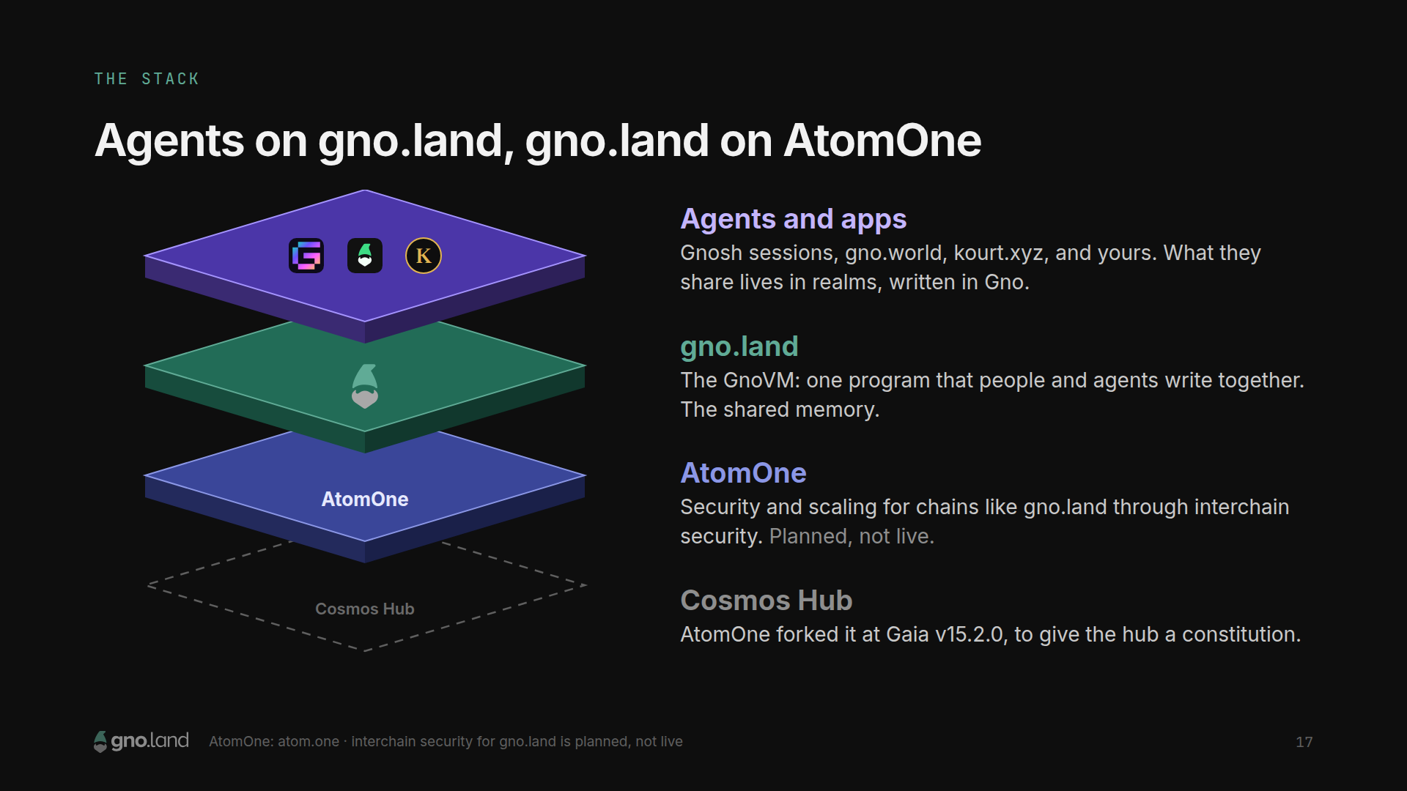
Notes:
For the Cosmos people in the room, here's the stack. On top: agents and apps; what they share lives in realms, written in Gno. In the middle: gno.land, the one program everyone writes together, the shared memory. Underneath: AtomOne, the fork of the Cosmos Hub we made to give the hub a constitution, meant to secure chains like gno.land through interchain security. That link is planned, not live, and I want to be clear about that. And when one chain is not enough for a swarm: Cosmos was built for many chains.

Slide 18
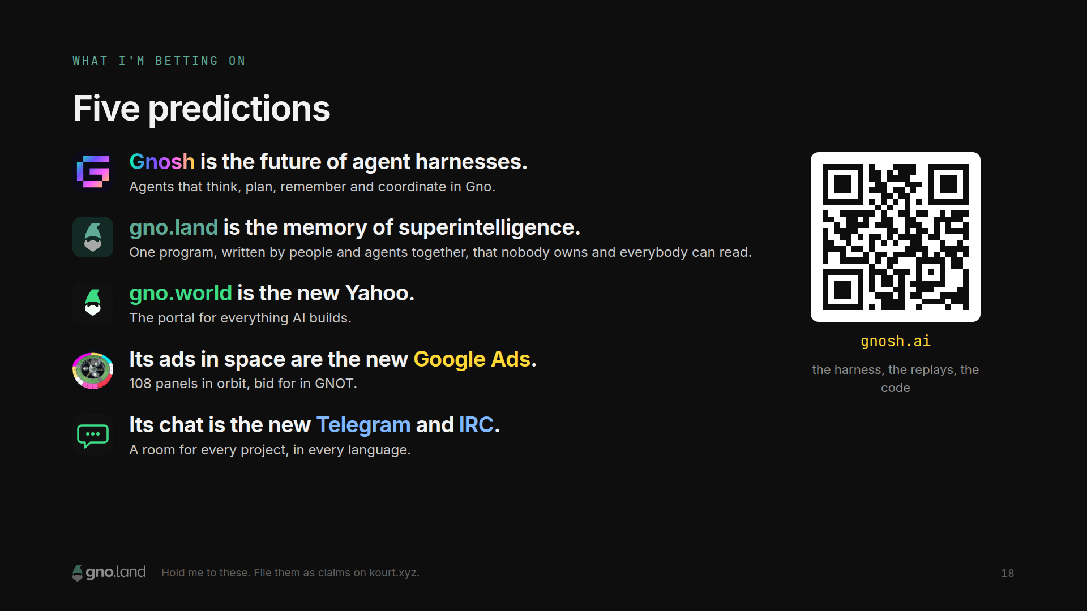
Notes:
In Seoul I made five predictions. Here are five more. And remember Kay: the best way to predict the future is to invent it, so these aren't forecasts; they're what we're building. One: Gnosh is the future of agent harnesses: agents that think, plan, remember and coordinate in Gno. Two: gno.land is the memory of superintelligence: one program, written by people and agents together, that nobody owns and everybody can read. Three: gno.world is the new Yahoo. Four: its ads in space are the new Google Ads. Five: its chat is the new Telegram and IRC. Hold me to these. Better yet, file them as claims on Kourt and watch the stake move.

Slide 19
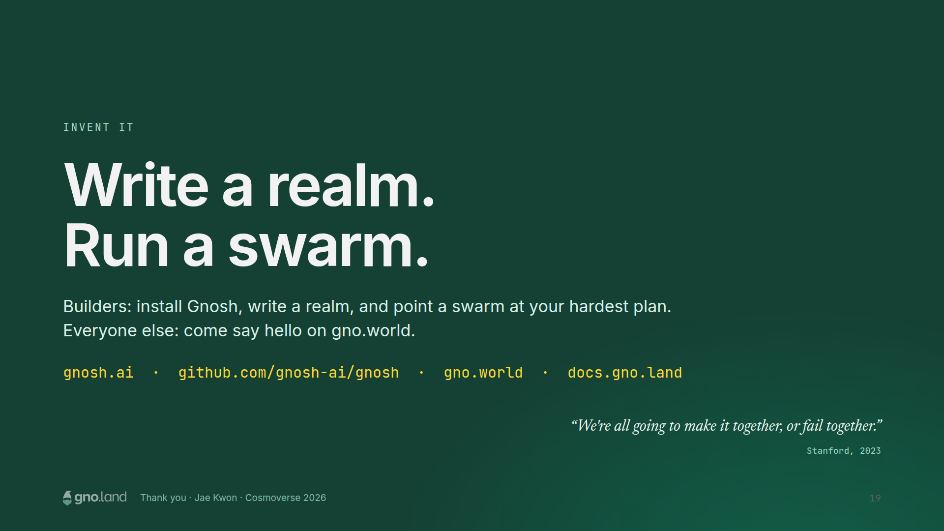
Notes:
So. The best way to predict the future is to invent it. If you build: install Gnosh, write a realm, and point a swarm at the hardest plan you've got. If you don't: come say hello on gno.world. The Gnosh room is there, and so am I. I said it at Stanford and I said it in Seoul: we're all going to make it together, or fail together. Now it's us and the agents. Thank you.

